Slide 1

Investment Assistant
Team:
Mounika Rendella
Shravya Lavu
Darron Brown

Slide 2
Introduction/Benefits
Application aids investors in their investment decisions.
Application educates users about the stock market.
Application informs investors of the desirability of the stock.
Helps Investors create a diverse investment portfolio and prepare them for retirement down the road.

Slide 3
Website functionalities
System maintains several customer profiles.
Website periodically retrieves stock information from yahoo financial website that collects stock price data.
Parses the received responses, extracts all necessary parameters and stores them in local MySQL database.
Displays current stock values of the different companies selected and displays graphs to show trend of stock values over past one year.

Slide 4
Limitations
Stock symbols are limited to only 5.
Graphs are displayed for one year time period only.
Charts are not interactive.
Performance may be affected if more stock symbols are added as latest price is evaluated using live data.

Slide 5
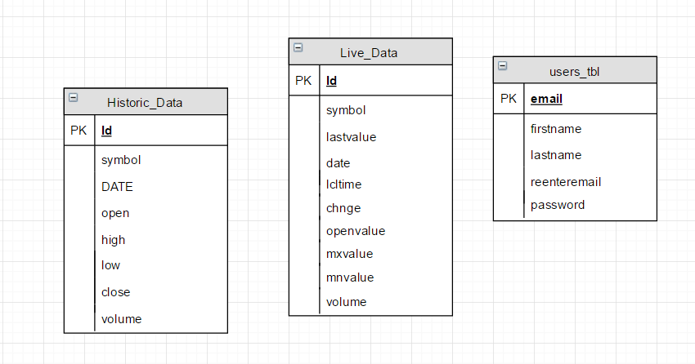
Data Tables

Slide 6
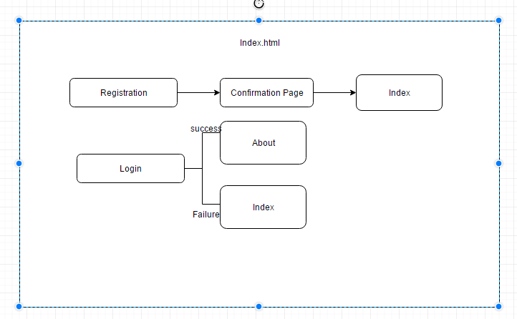
Application Flow
Registration/Login Page :

Slide 7
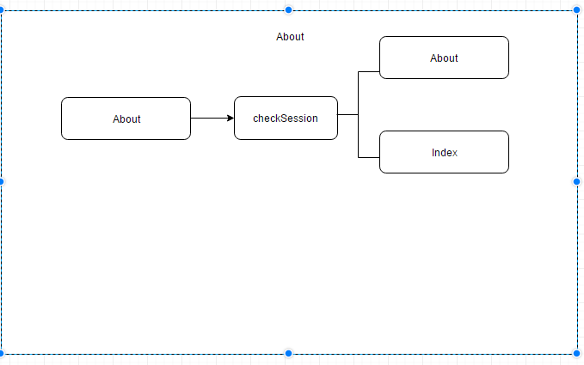
Application Flow
Home Page:

Slide 8
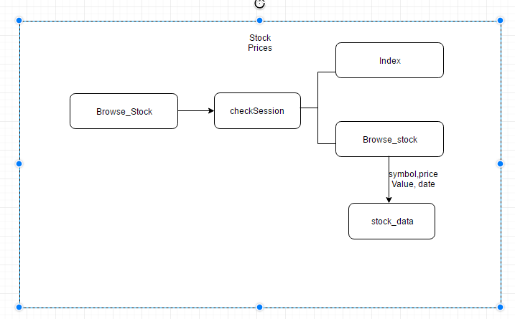
Application Flow
Browse Stock Prices Page:

Slide 9
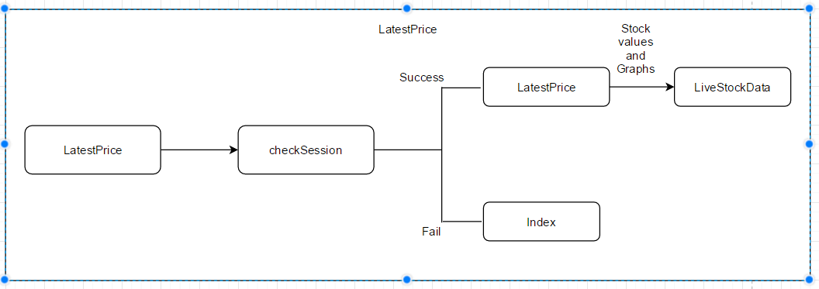
Application Flow
LatestPrice page:

Slide 10
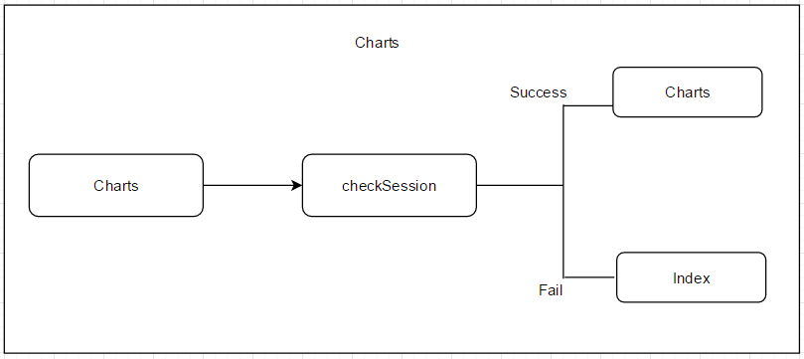
Application Flow
Charts Page:

Slide 11
DEMO

Slide 12
Thank You

